Slide 1
Ecommerce and Social Media
By Alexandra Baker, Farimah Shirmohammadi, Erika Gonzalez, Jordan Janer

Slide 2


Project Description:
This project aims to create a database that can examine the influence of social media
on ecommerce.
Research Questions:
What changes in ecommerce have arisen due to the influence of social media?
How does usage between social media platforms change overtime?
How does usage between devices change overtime?
What predictions can we make going forward?

Slide 3
Datasets:
Social Media Stats
https://gs.statcounter.com/social-media-stats/all/united-states-of-america/#monthly-201901-202112-bar
Estimated Food and Services Sales by Kind of Business (US Census 1992-2021)
https://view.officeapps.live.com/op/view.aspx?src=https%3A%2F%2Fwww.census.gov%2Fretail%2Fmrts%2Fwww%2Fmrtssales92-present.xls&wdOrigin=BROWSELINK

Slide 4
Extract

Slide 5
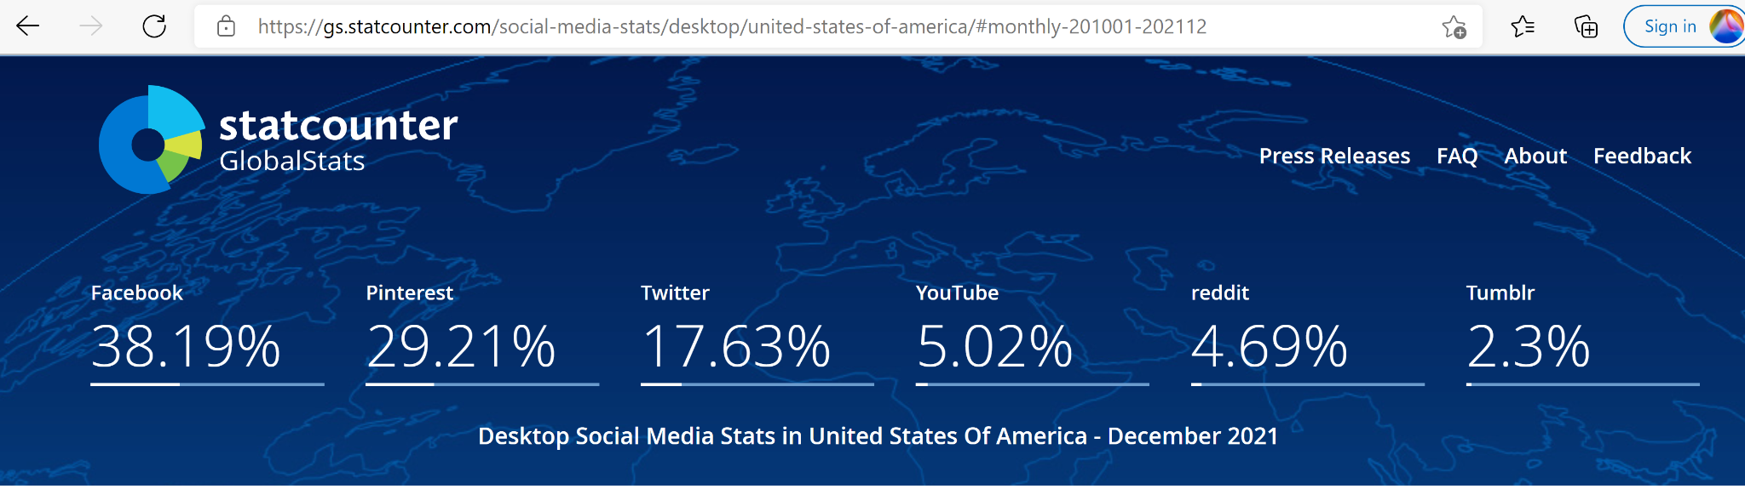
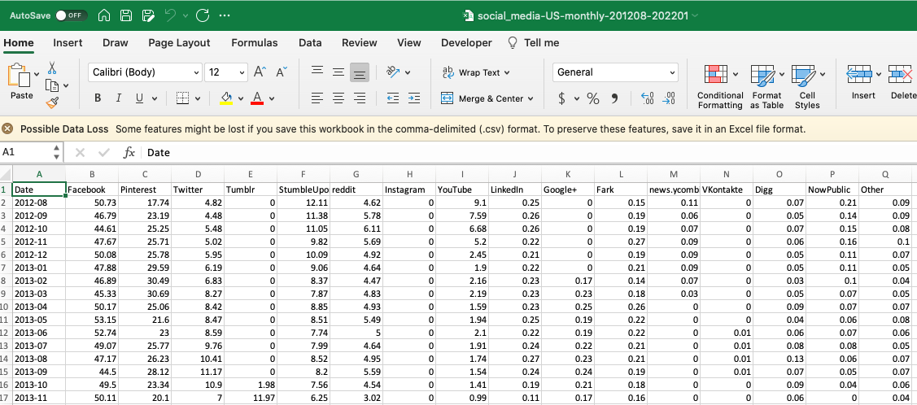
Looked at statcounter for social media activity across different platforms in the United States
Extracted data from 2010 to 2021
Only considered social media activity across
Facebook, Twitter, Instagram, Google+, Reddit and YouTube for all devices (mobile, desktop and tablet)
Notes:
Stats are pulled from all browsers and search engines. These are updated every 45 days. The US sample size is a record of 2.7 billions page views.

Slide 6
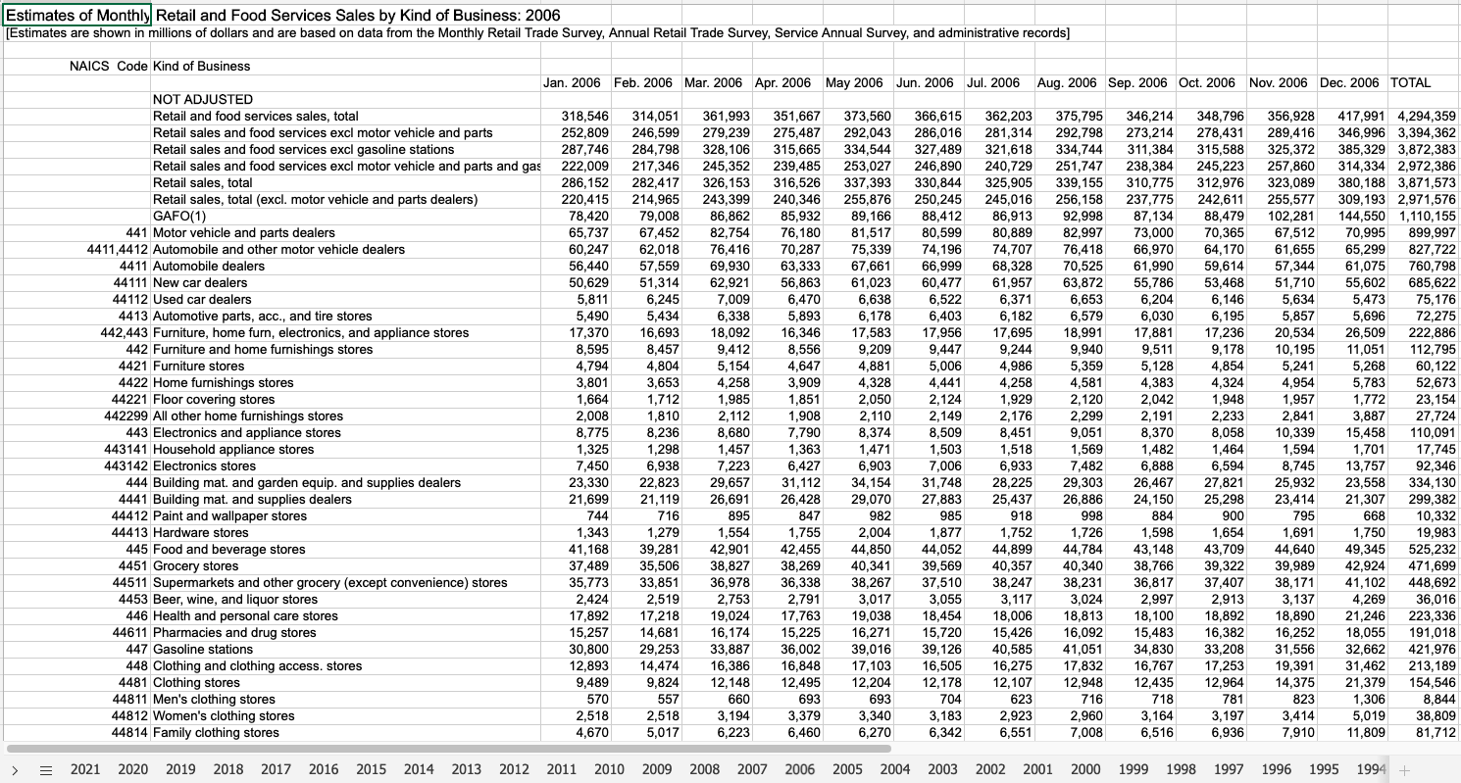
Notes:
1992-2021 monthly US Census Sales Data by Type of business. Shown in millions.

Slide 7
Transform

Slide 8
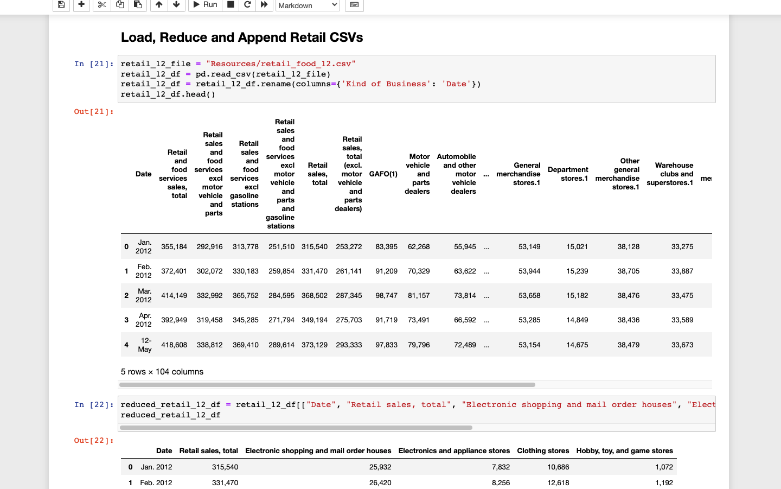
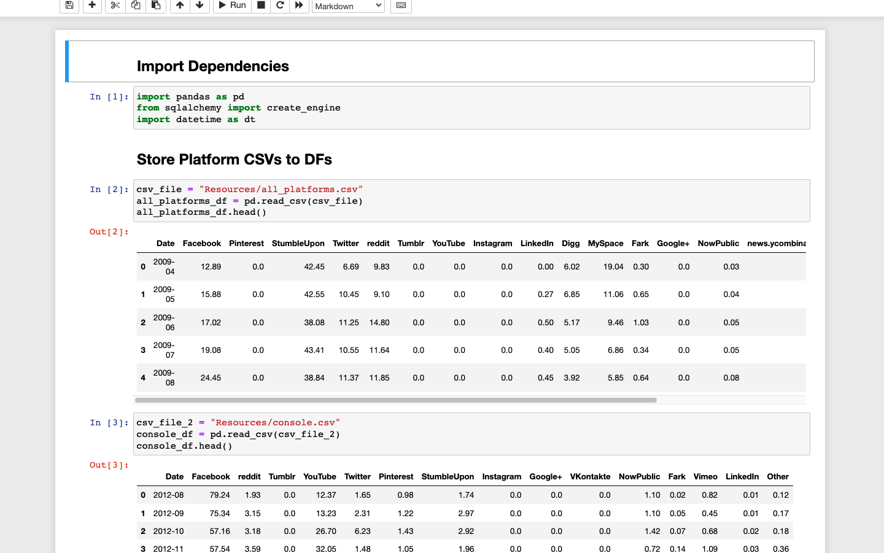
Store

Slide 9
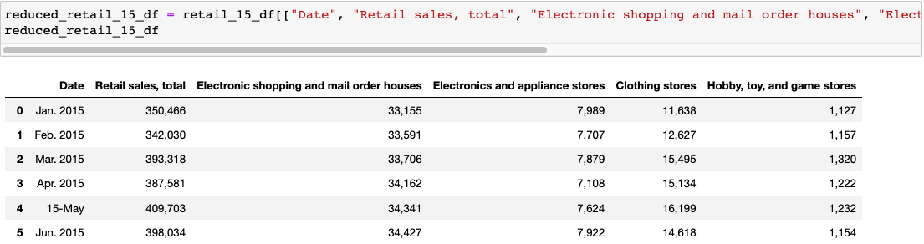
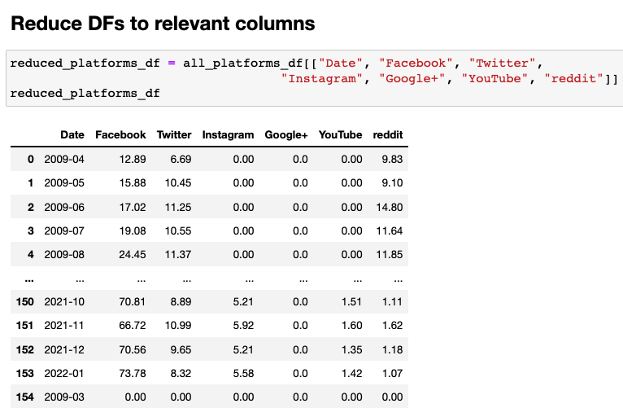
Reduce

Slide 10
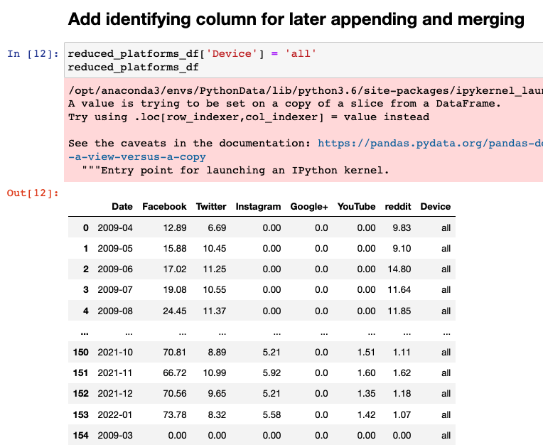
Add Identifying Column

Slide 11
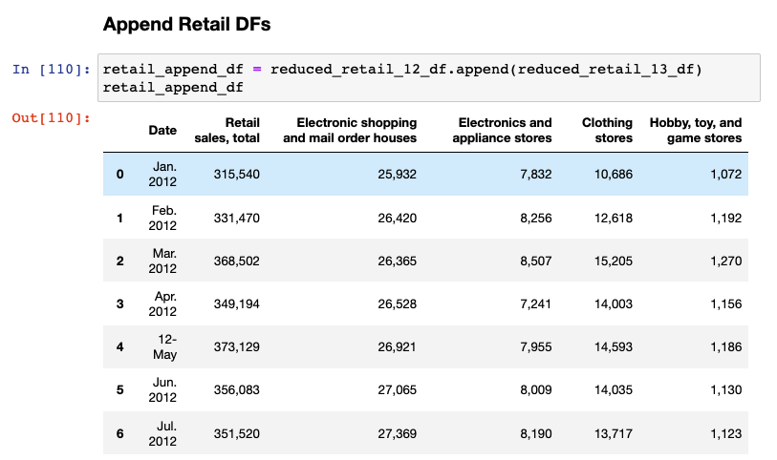
Append

Slide 12
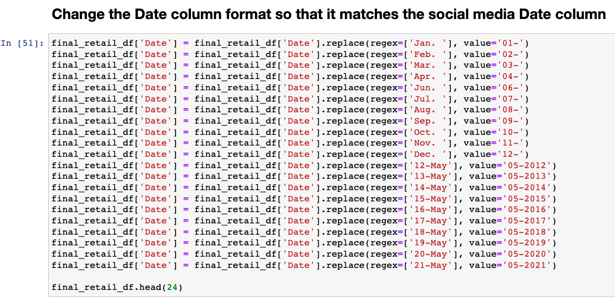
Replace Substring in Date Column

Slide 13
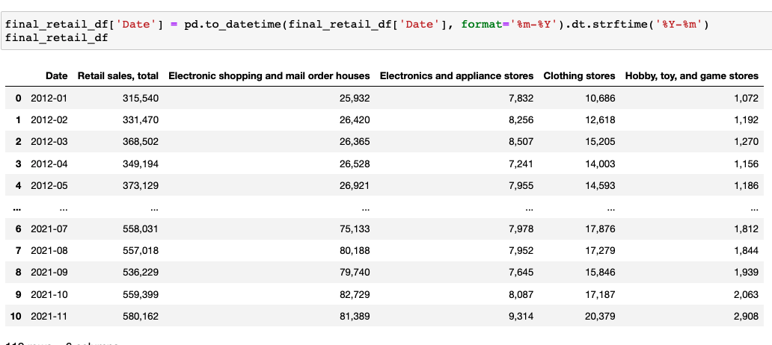
Change Date with Datetime

Slide 14
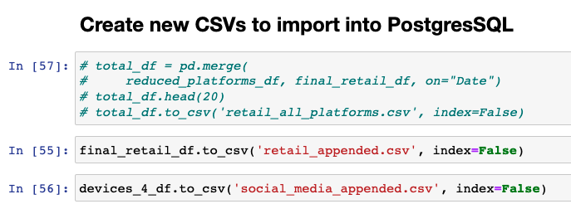
Create New CSVs

Slide 15
Load

Slide 16
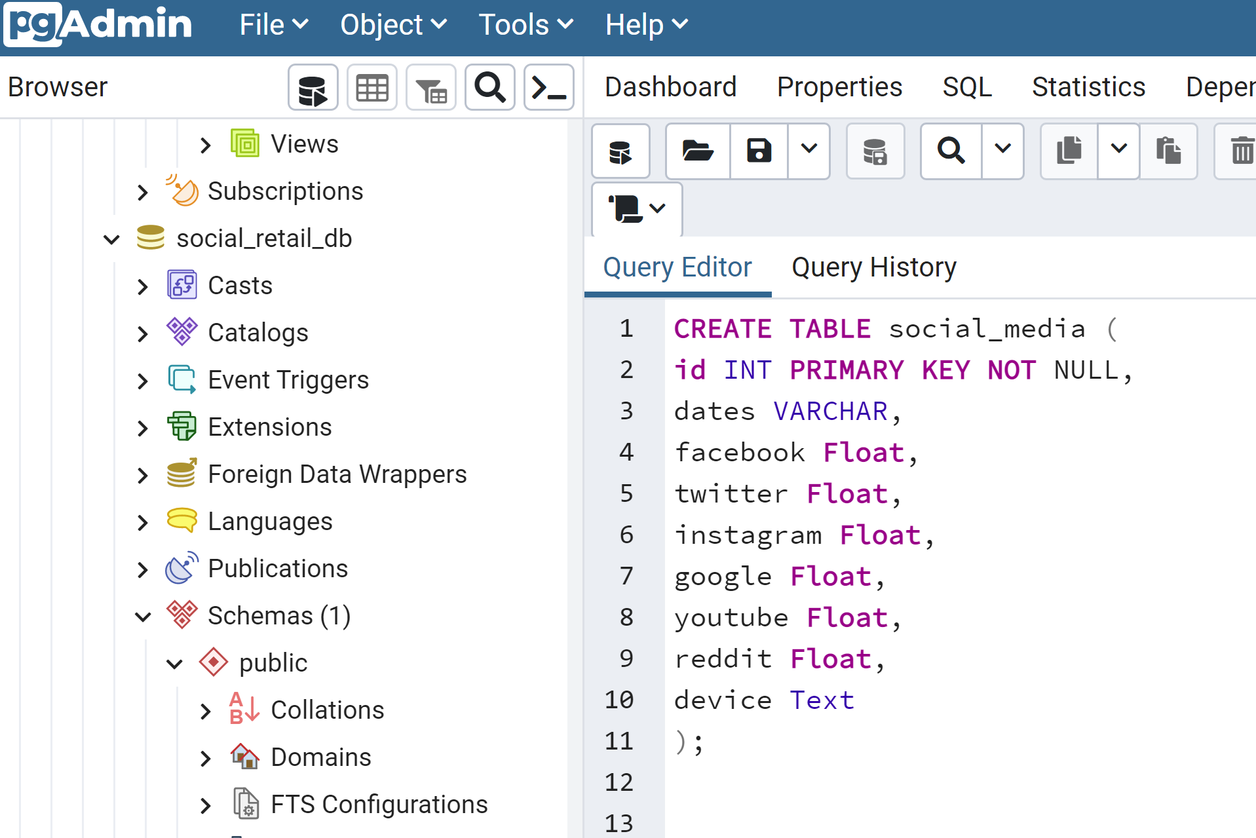
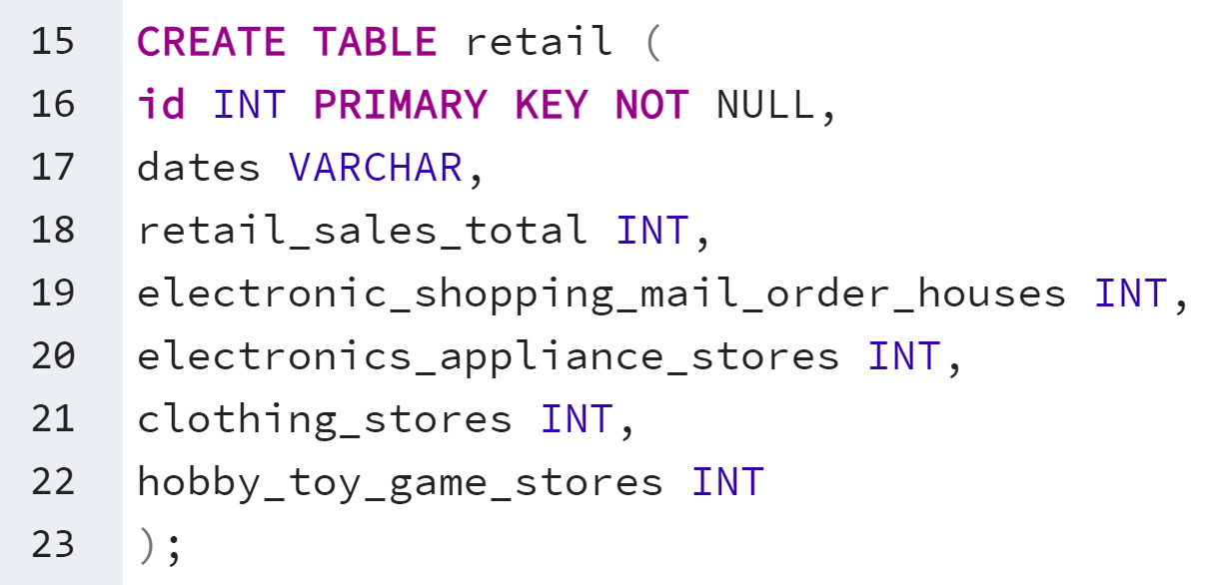
Creating Tables on Postgres

Slide 17
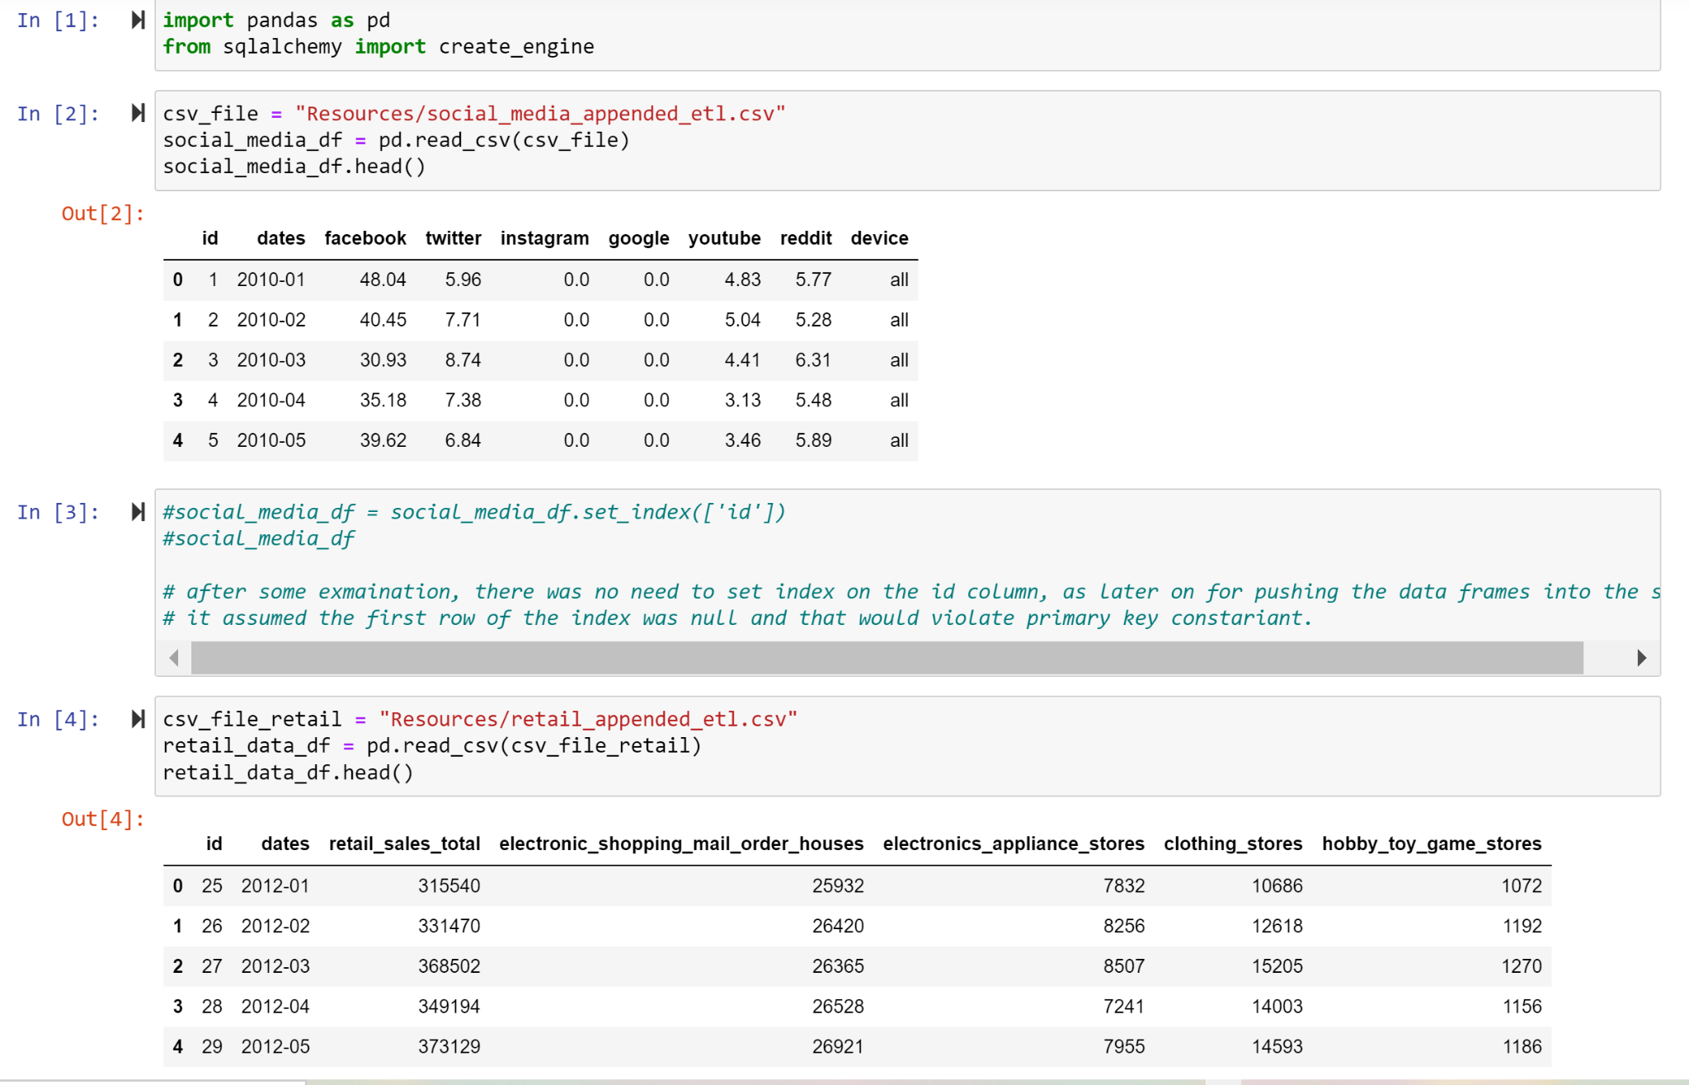

Slide 18
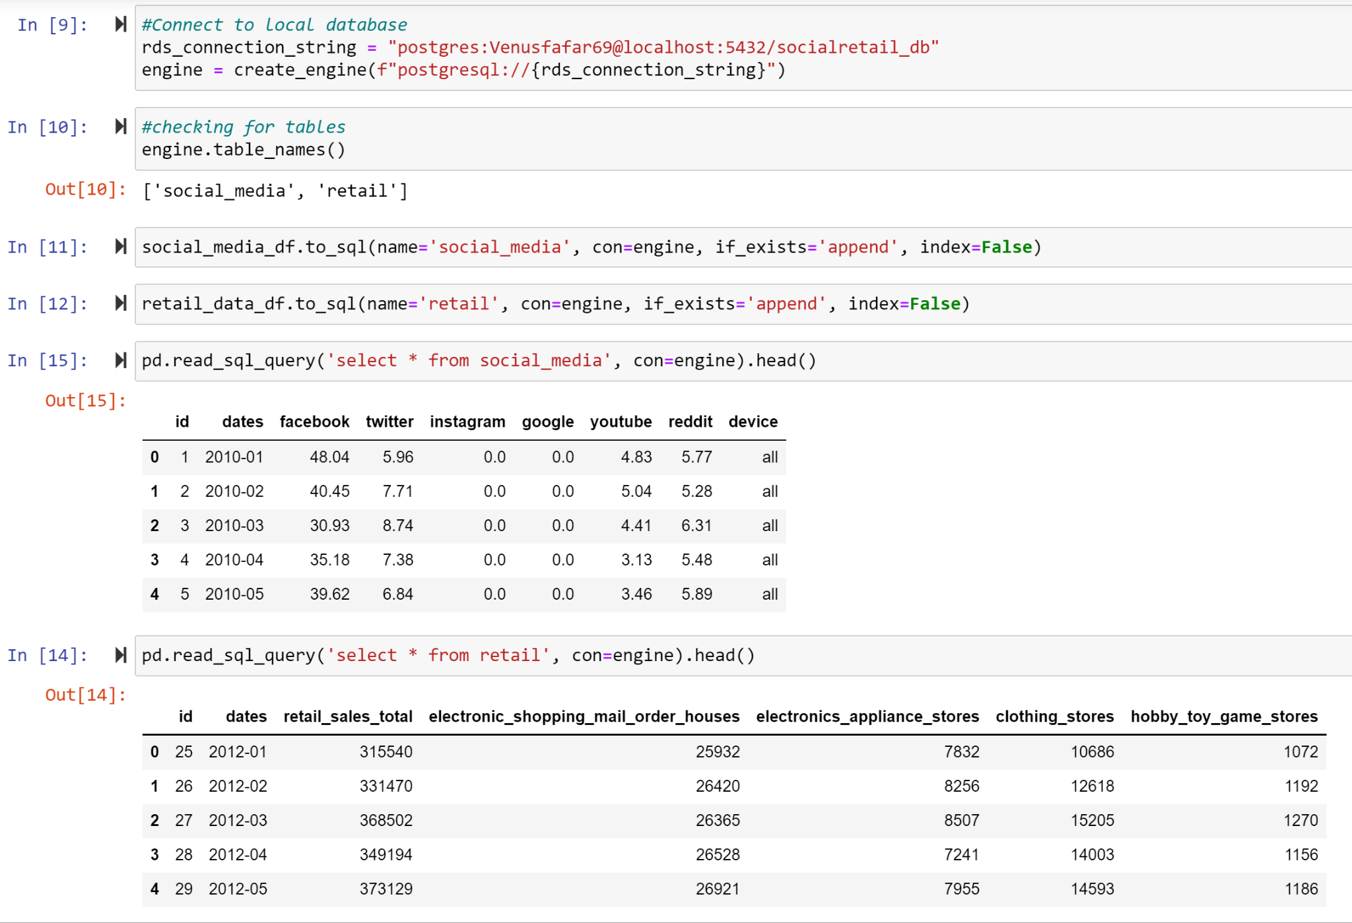

Slide 19
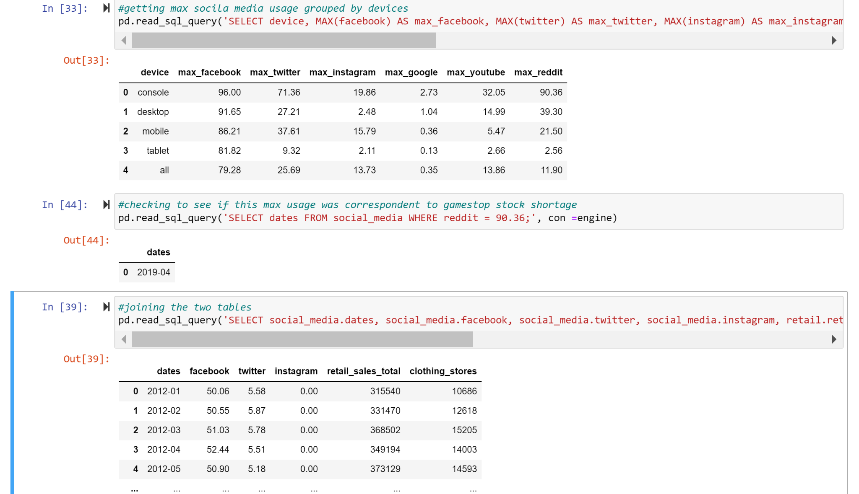
Max social media usage across different platform grouped by device and ordered in descending format
And few more analysis using SQL commands

Slide 20
Graphs

Slide 21
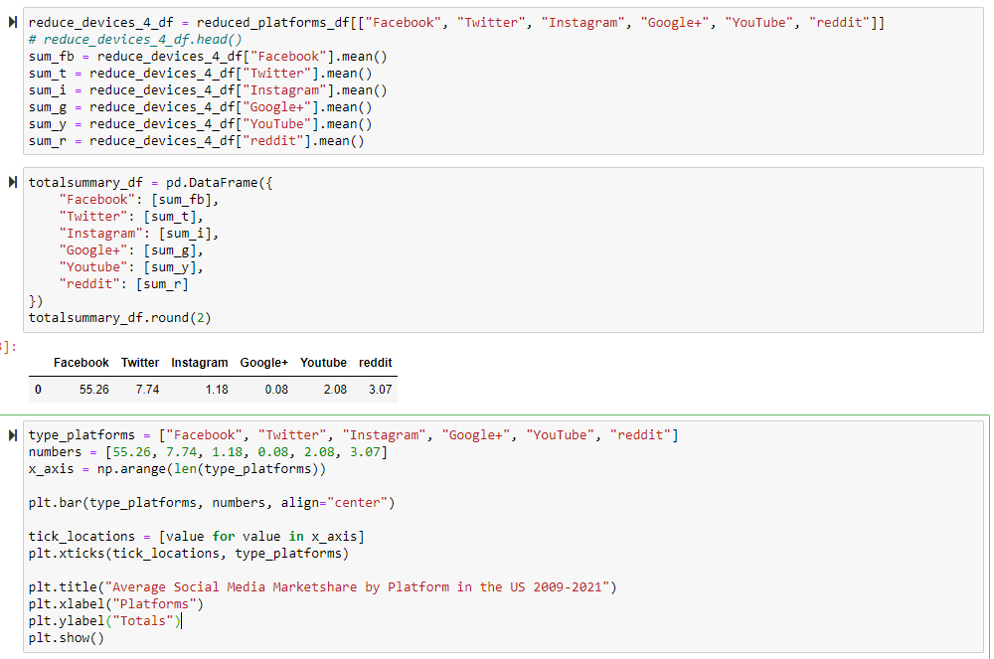
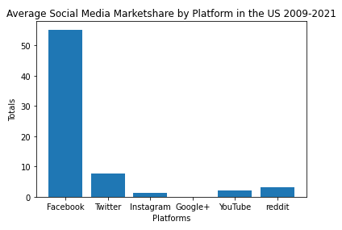

Slide 22
Conclusions
As popular social media sites increase in market share, so does retail sales
From 2009-2021, US desktop usage gradually decreased while mobile usage gradually increased until each device stabilized around the same amount of time being used.
People in the US could be online purchasing more from their mobile devices.
Marketing departments might want to improve or create company apps for mobile devices.
Notes:
We’ve noticed that over the years there’s been an increase in cell phone use as technology has improved
We also noticed a huge jump in retail sales especially during the shutdown
Why is this data important?
-also use the data to improve their ads on online platforms, use the data to see which platforms are most popular and get more traffic/clicks

Slide 23
Limitations
Not able to find affordable Social Media Ad Data
Social Media platform APIs no longer open
Social Media usage is based on page views only
Limited to a select amount of social media platforms
Size of sample data reflects a total of 2.7 billion page views for United States
Alternative methods : use 1992-2021 Census Sales Data for pre/post analysis of Retail Sales and Social Media

